Slide 1
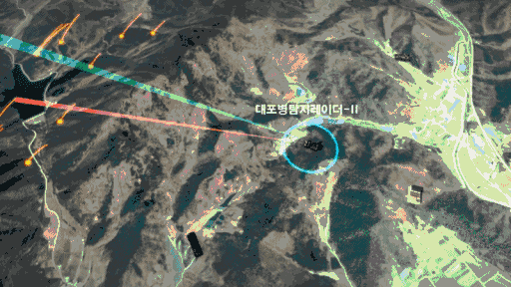


DOA Estimation
Background，Algorithms，Calculation，Detail，Conclusion
Wei Xinyuan，Zhang Yiyang
Notes:
大家好，我们本次报告的主体是软体机器人

Slide 2
Contents
01
DOA Tech Background
02
DOA Algorithms
03
Range-Doppler Calculation
04
Experience Detail
05
Conclusion
Notes:
四个部分

Slide 3
First
DOA Tech Background

Slide 4

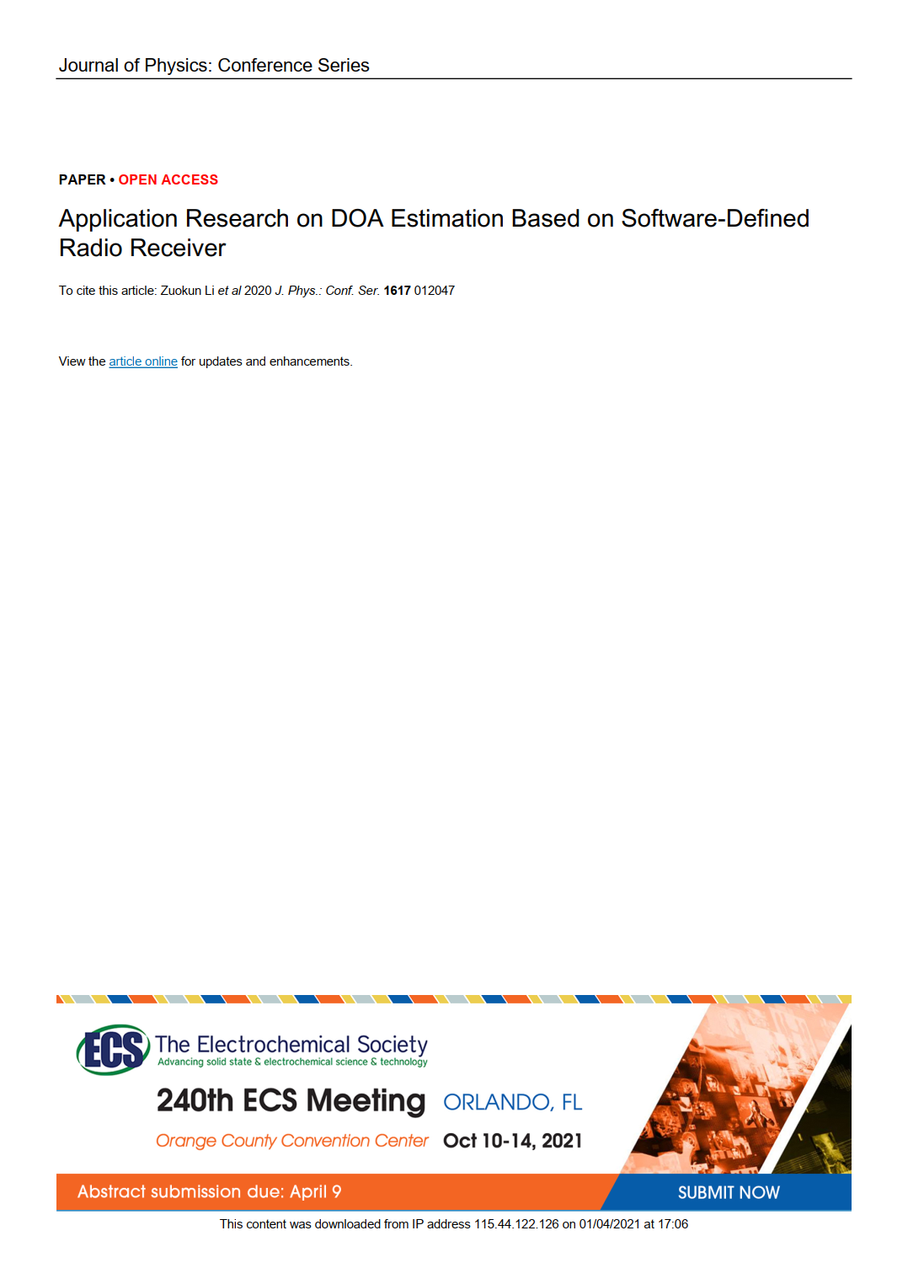

DOA Tech Background
Direction of arrival estimation is an active field in array signal processing.
It has broad application value in the fields of communication, radar , exploration and navigation.
This article focuses on the engineering application of DOA estimation

Slide 5
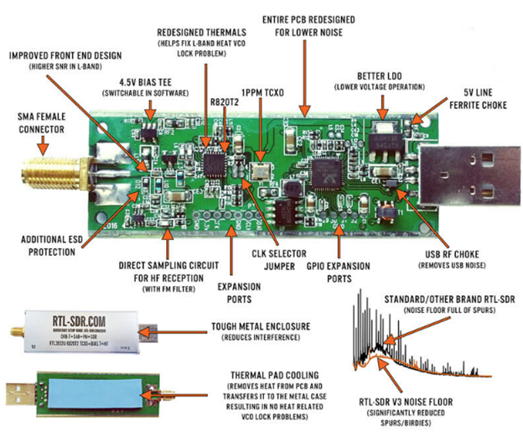
DOA Tech Background
KerberosSDR is a new 4-input Coherent RTL-SDR.
It can receive radio frequency signals from 25MHz to 1.75GHz in space and convert it to baseband.

Slide 6

DOA Tech Background
The four signal receiving channels share a clock source, and the four digital signals communicate with the Raspberry Pi through a USB HUB.
Run the signal processing algorithm on the Raspberry Pi and display the DOA estimation result and signal strength in real time through the web page.

Slide 7
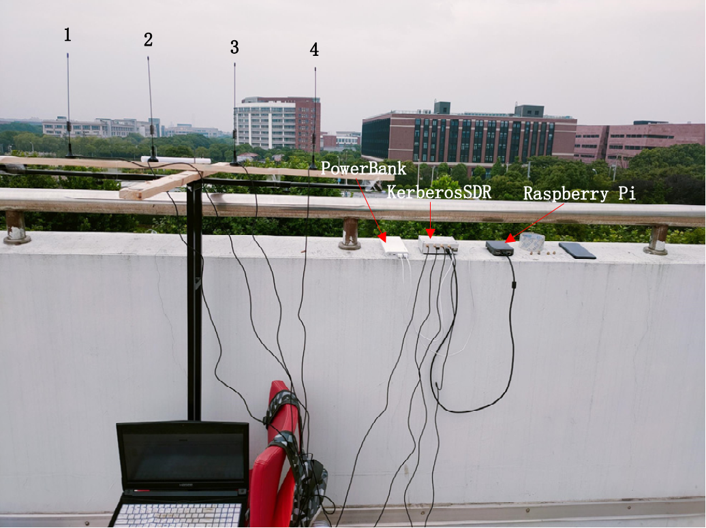
DOA Tech Background
The communication frequency between the UAV and the remote control in this experiment is 2.400- 2.4835 GHz
The UAV equipped with a FM transceiver hovers in the air, so as to ensure that the signal sent by the FM transceiver is not blocked by obstacles

Slide 8
Second
DOA Algorithms

Slide 9
DOA Algorithms
Delay-Sum Beamformer
Traditional:
CBF/Bartlett BF
Capon LMS/Capon BF/MVDR
Root MUSIC
MUSIC
Decoherence MUSIC
DOA
Subspace:
Beamspace-Base MUSIC
ESPRIT
TAM
Deterministic ML
LS-ESPRIT
ML:
TLS-ESPRIT
Stochastic ML
https://wenku.baidu.com/view/eece77f8c67da26925c52cc58bd63186bceb9201.html

Slide 10
DOA Algorithms
We focus on the MUSIC algorithms
Subspace:
Root MUSIC
MUSIC
Decoherence MUSIC
Beamspace-Base MUSIC

Slide 11
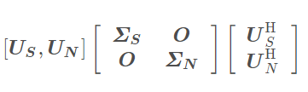
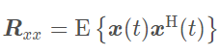
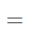
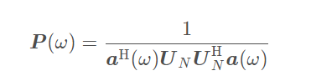
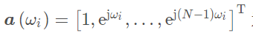
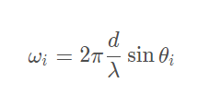
DOA Algorithms
MUSIC
利用了信号子空间和噪音子空间相互正交的性质
Multiple Signal Classification
多信号分类算法
https://blog.csdn.net/qq_36583373/article/details/109333087

Slide 12

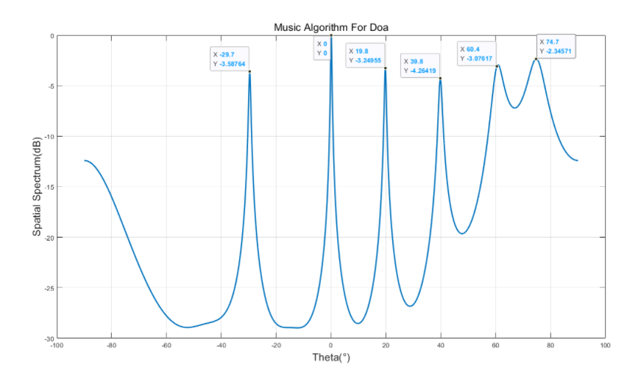
DOA Algorithms
通过改变空间参数也就是theta，进行谱峰搜索，确定信号方向
https://blog.csdn.net/qq_36583373/article/details/109333087

Slide 13
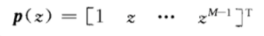
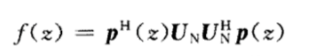
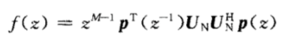
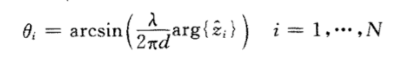
DOA Algorithms
这里的z就是前面的信号空间特征值对应的特征向量
Root MUSIC
为了降低计算复杂度，省去共轭z项，将式子改写成
直接求根，从而计算出theta值
https://blog.csdn.net/weixin_38452468/article/details/73274627

Slide 14
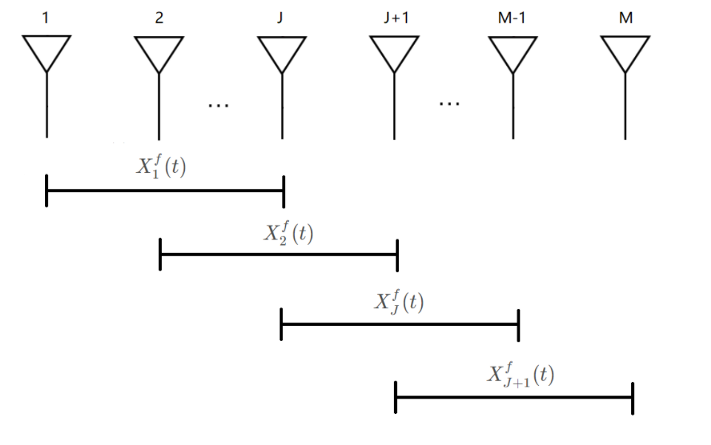
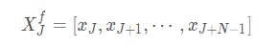
DOA Algorithms
前后向空间平滑算法
We focus on the MUSIC algorithms
Decoherence MUSIC
解相干的MUSIC算法
传统算法在处理相干信号的时候DOA结果并不理想
https://blog.csdn.net/qq_36583373/article/details/109364878

Slide 15
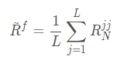
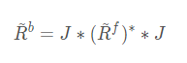
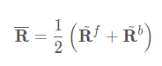
DOA Algorithms
前后向空间平滑算法
We focus on the MUSIC algorithms
Decoherence MUSIC
解相干的MUSIC算法
传统算法在处理相干信号的时候DOA结果并不理想
https://blog.csdn.net/qq_36583373/article/details/109364878

Slide 16
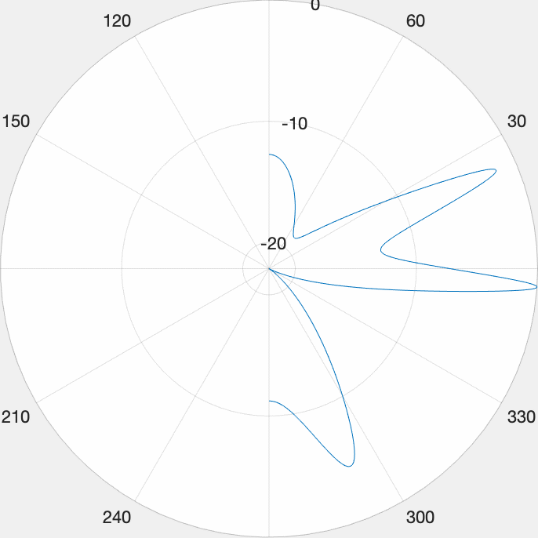
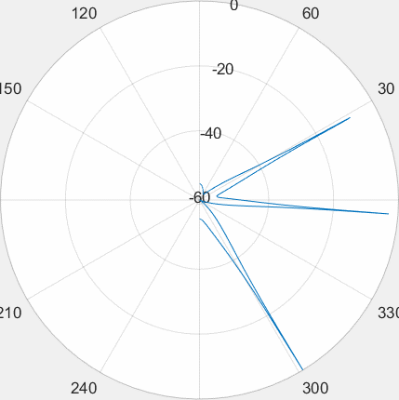
DOA Algorithms
MUSIC
Decoherence MUSIC
空间谱搜索
前后向空间平滑算法

Slide 17
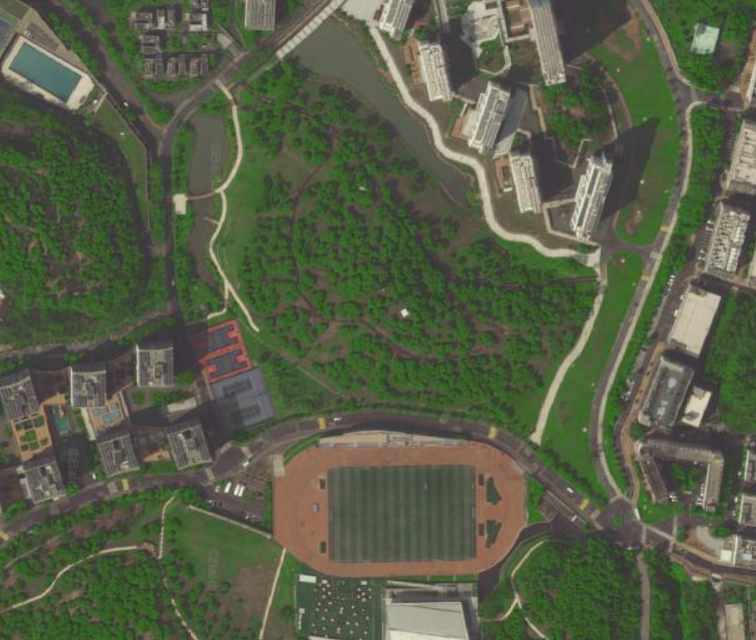
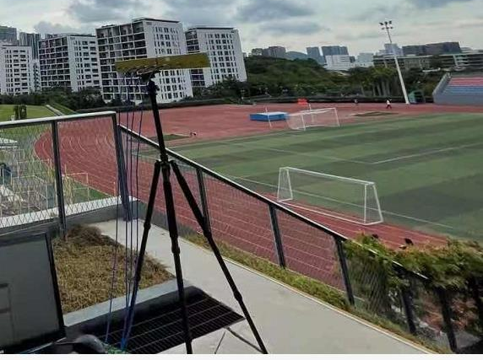
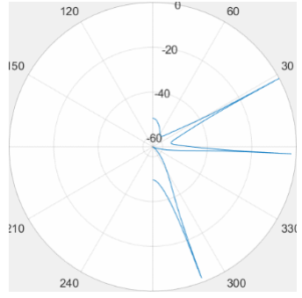
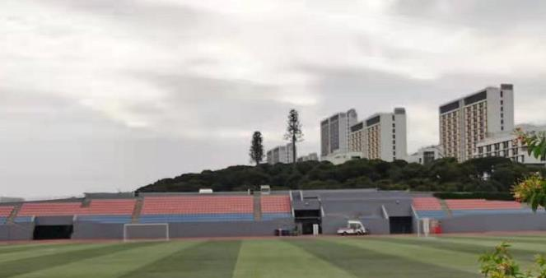
DOA Algorithms
新生宿舍
基站大概位置
专家公寓
慧园
接收机位置

Slide 18
Third
Range-Doppler Calculation

Slide 19
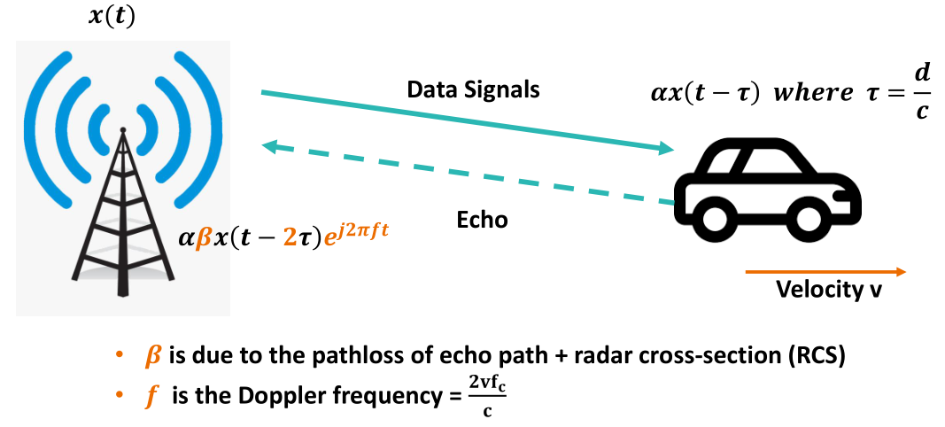
Range-Doppler Calculation
From Rui Wang’s Lecture

Slide 20
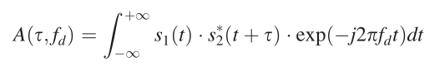
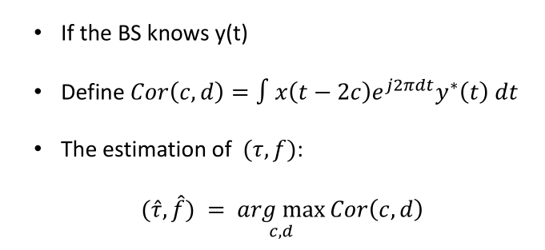
Range-Doppler Calculation
Ambiguity Function

Slide 21
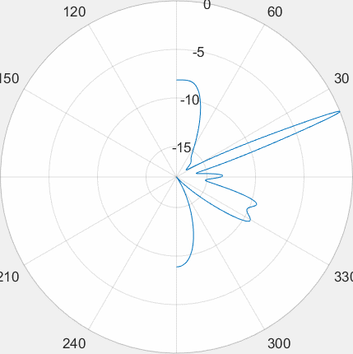
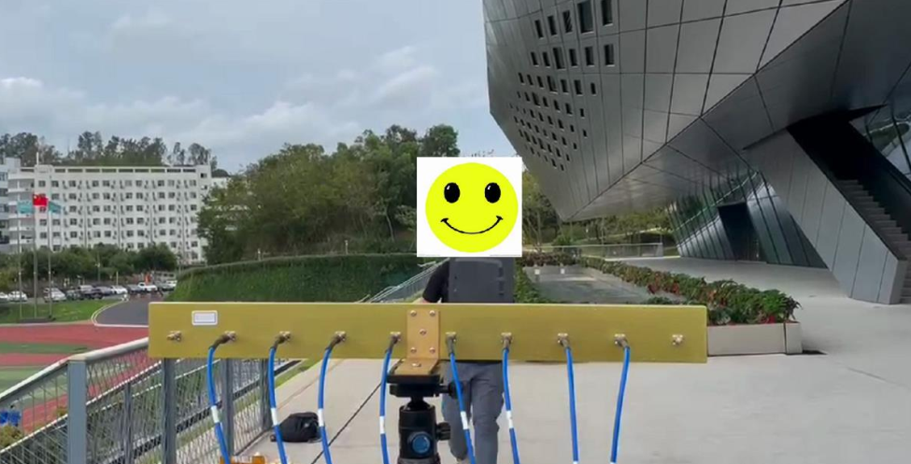
Range-Doppler Calculation

Slide 22
Range-Doppler Calculation
Deg = -20
Deg = 30

Slide 23
Range-Doppler Calculation
Deg = 29
Deg = 30
Deg = 31

Slide 24
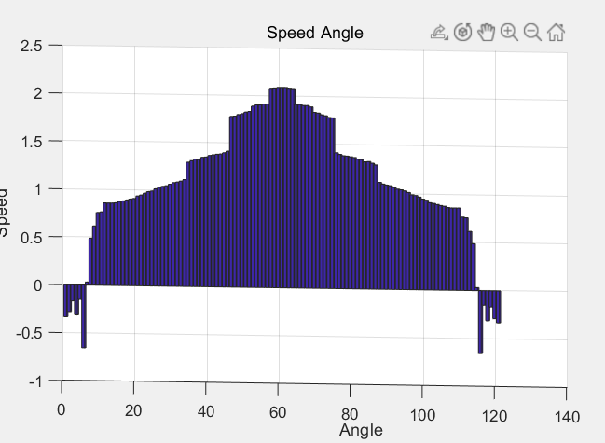
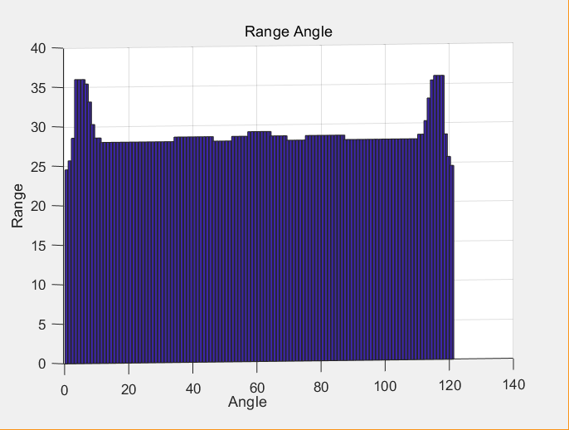
Range-Doppler Calculation
Ambiguity Function

Slide 25
Experiment Detail
信号采样
时钟同步
数字混频
低通滤波
波束赋形
直达波、杂波消除
求Ambiguity Value
作RD图

Slide 26
Fourth
Experience Detail

Slide 27
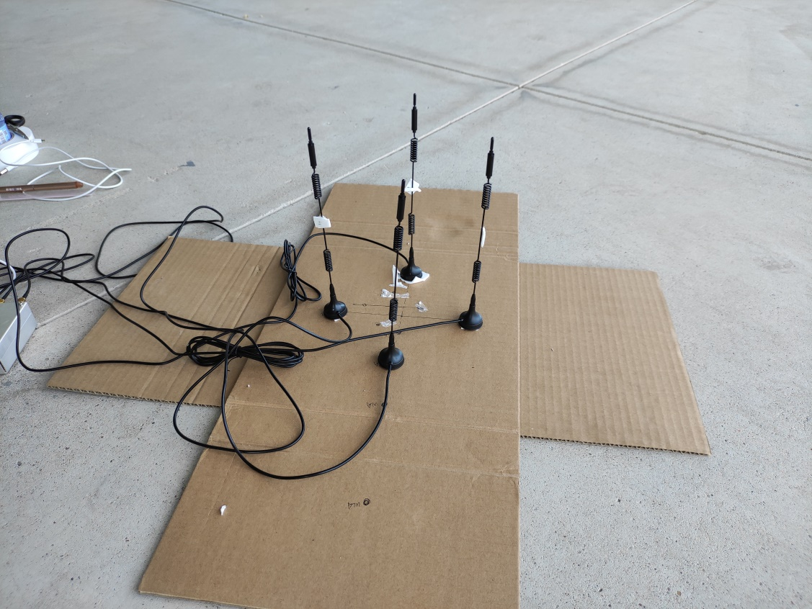
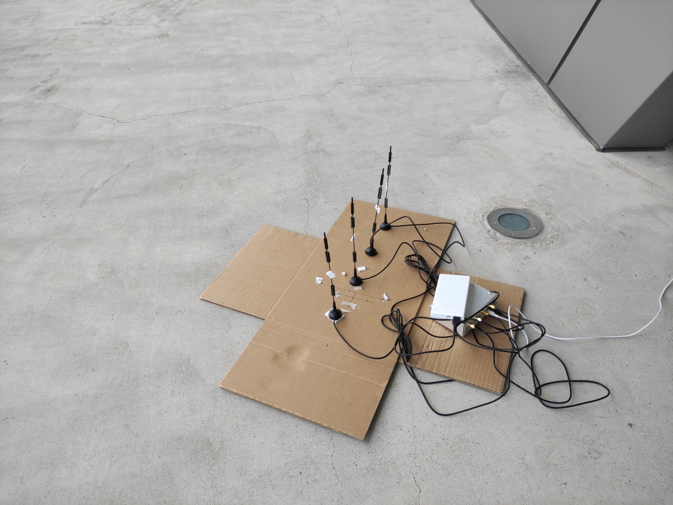
Experience Detail

Slide 28
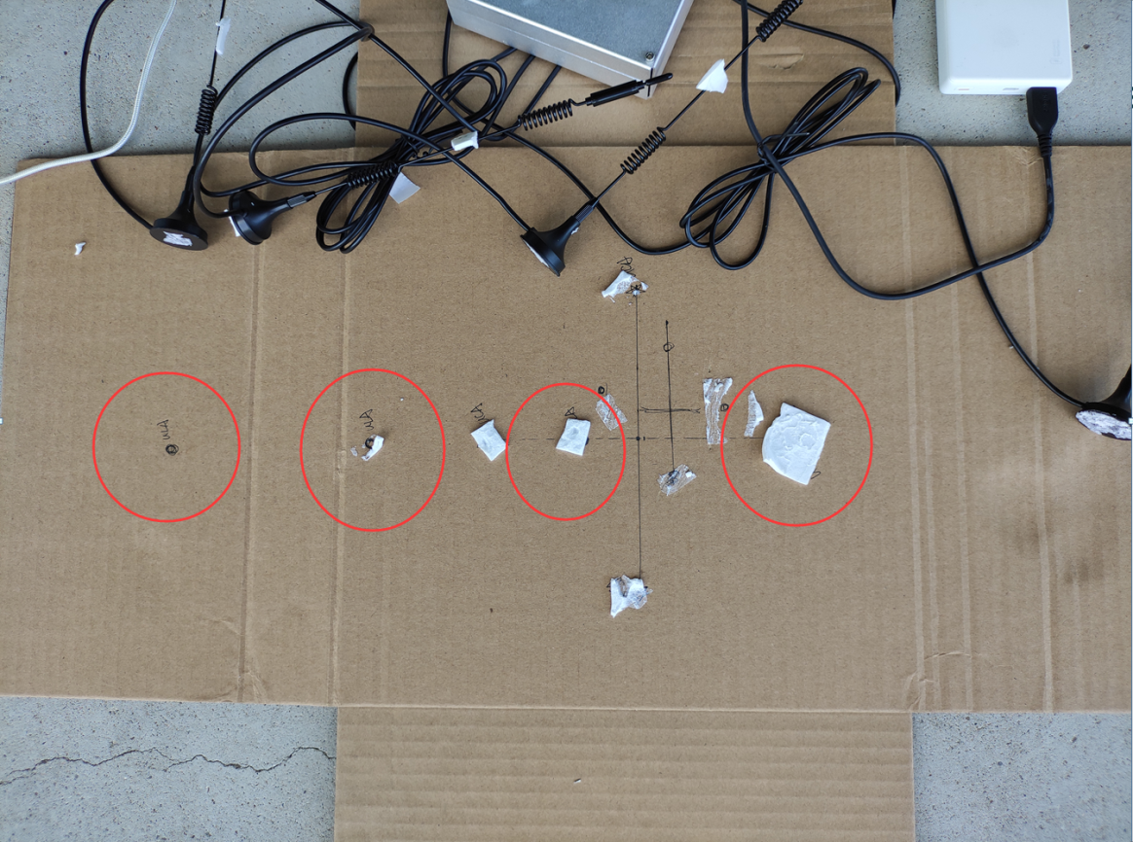
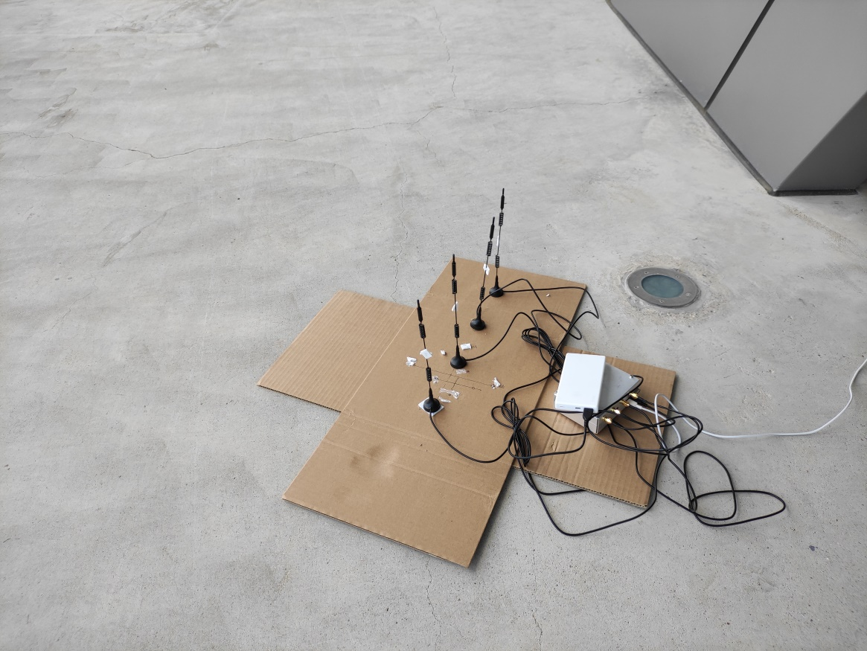
Experience Detail
Side-by-side array antenna

Slide 29
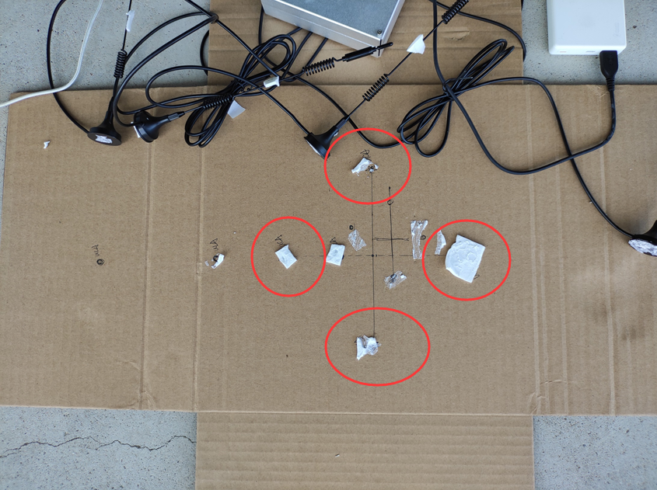
Experience Detail
Circular array antenna

Slide 30
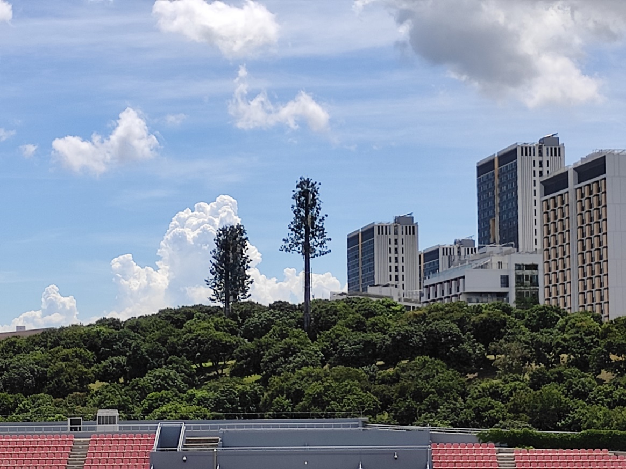
Experience Detail
Signal source detection
In the experiment, we chose two signal sources, one is the signal source that Professor Wu gave us that can switch the frequency, and the other is the fixed signal source in the school, which is the communication base station. Here we try to choose different generations The communication frequency of the operator can be detected. From the public information, we can find the communication frequency used by the operator.

Slide 31
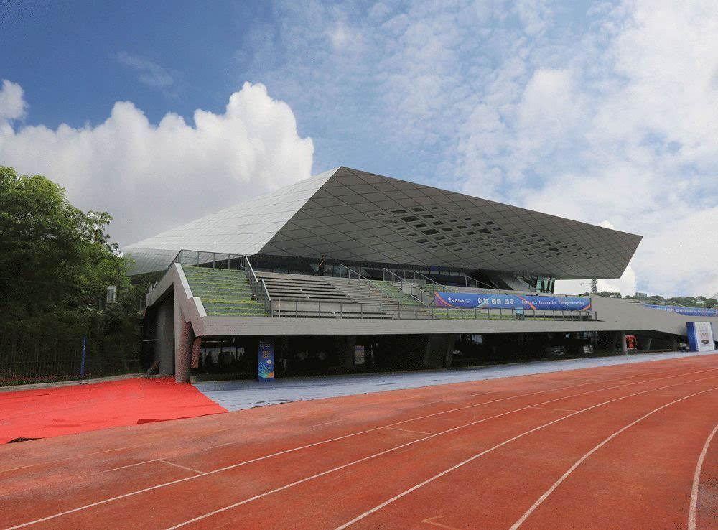
Experience Detail
Signal source detection
The experimental location we chose is Songhe Stadium, where the distance from the base station signal source is relatively moderate, the venue is also wide enough, and the multipath effect is relatively weak.

Slide 32
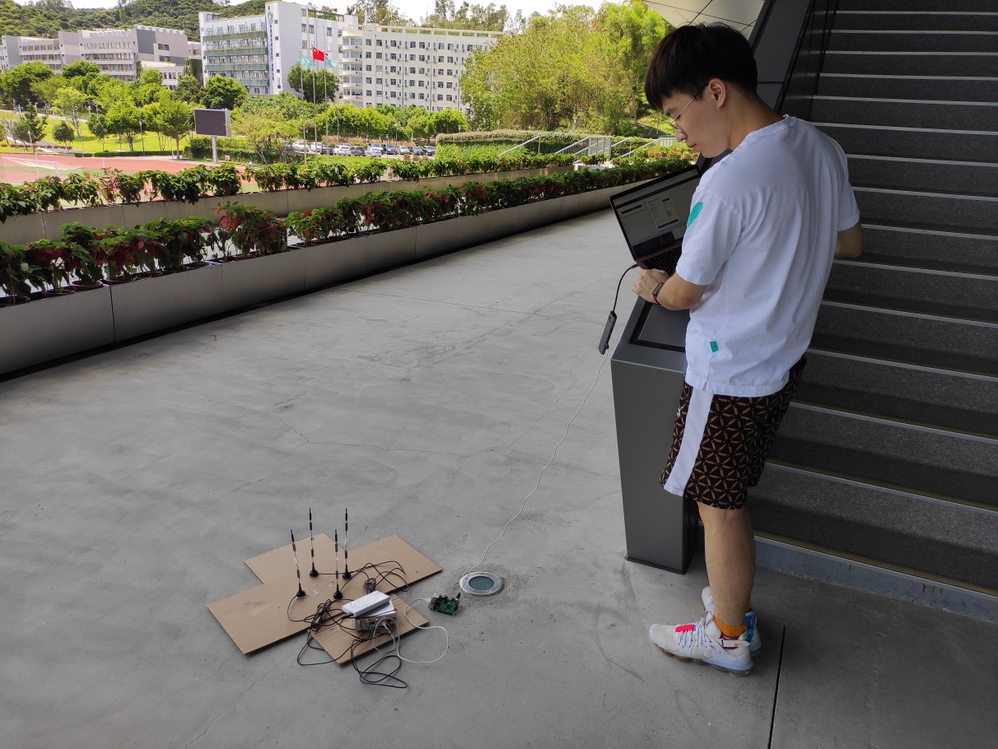
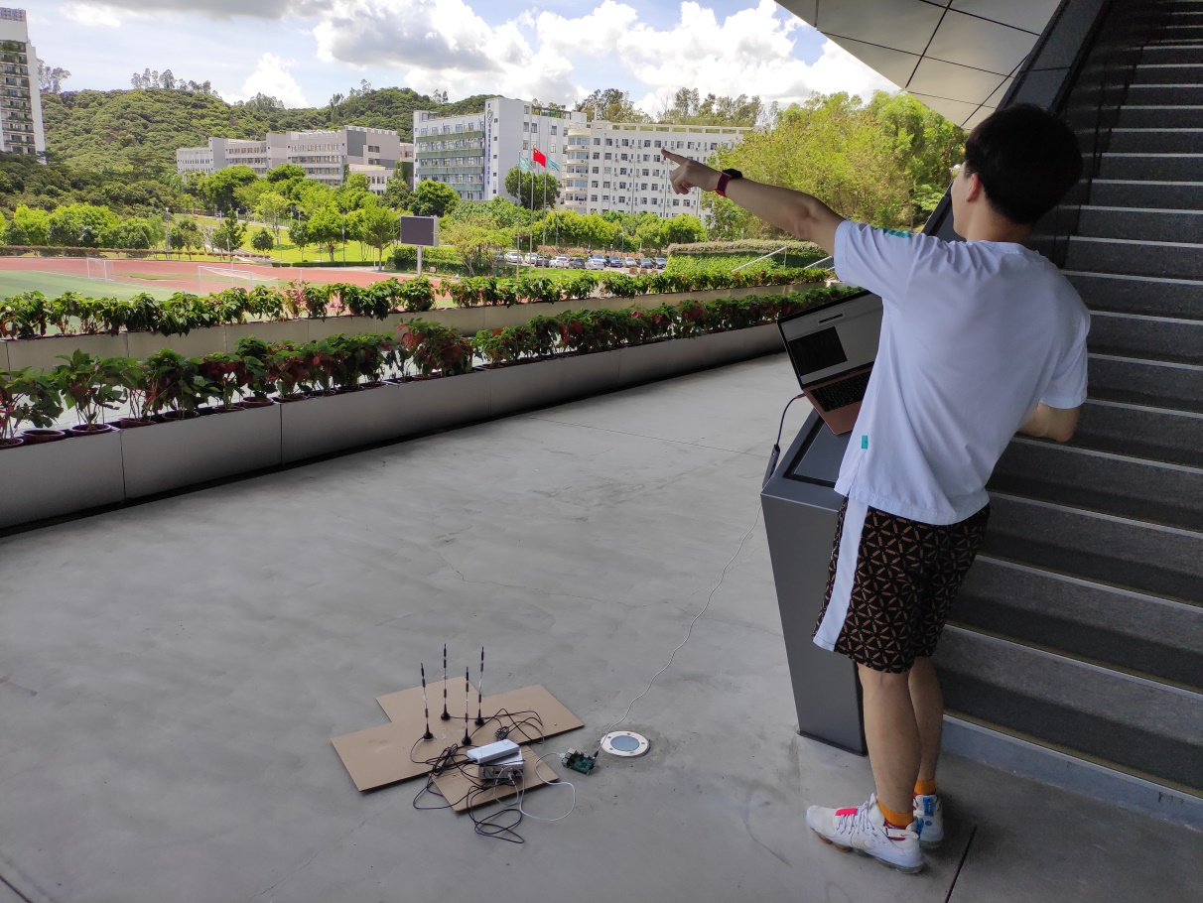
Experience Detail
experiment procedure

Slide 33
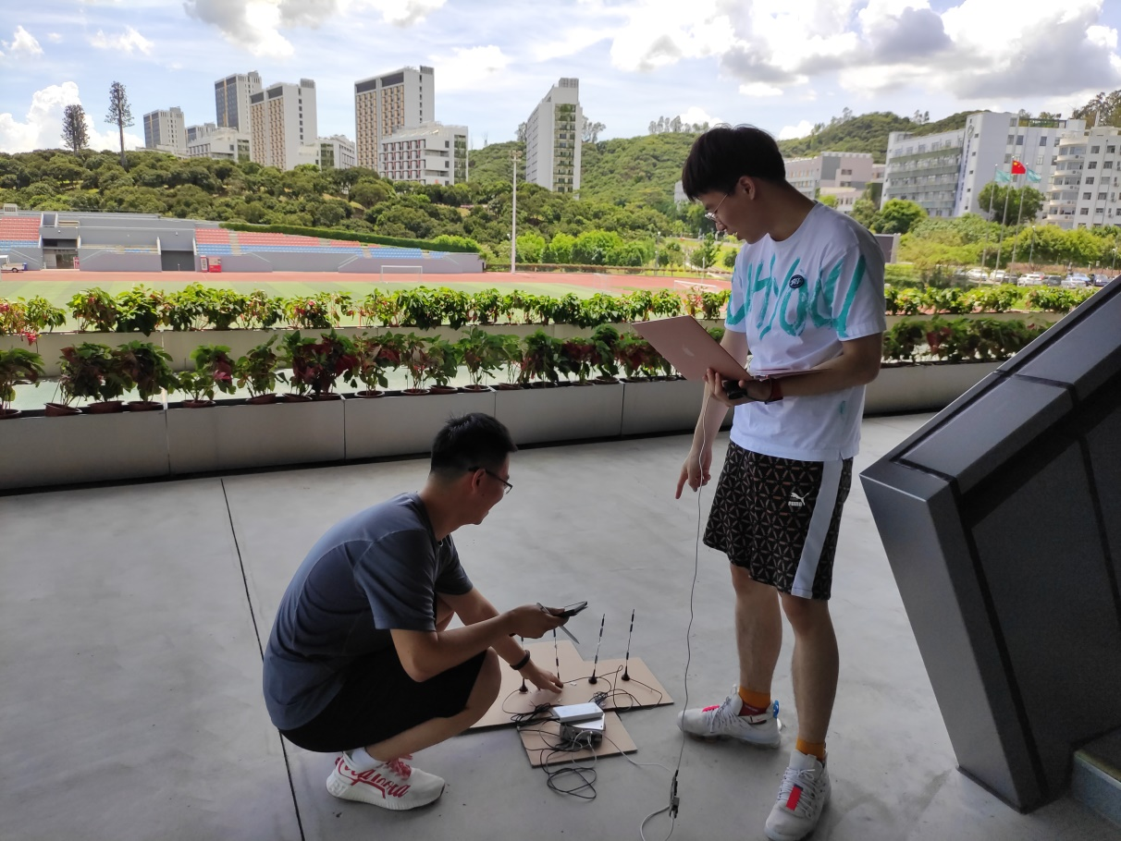
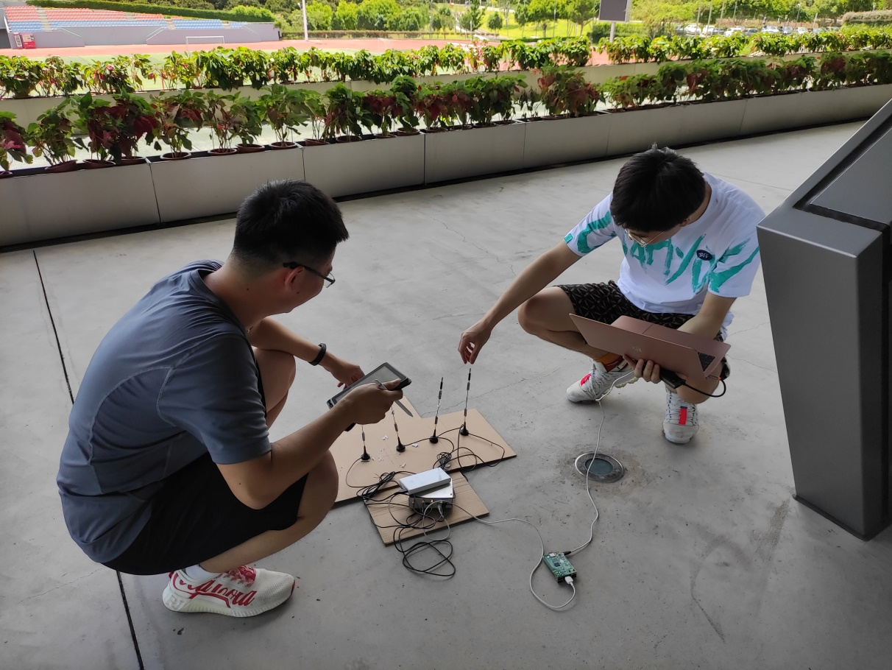
Experience Detail
experiment procedure

Slide 34
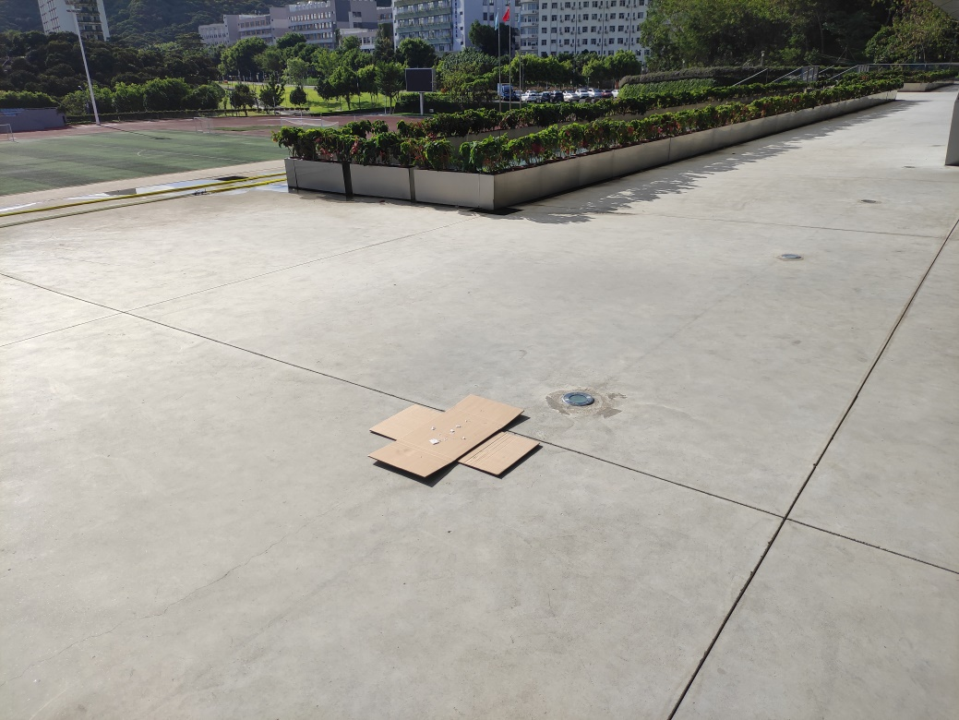
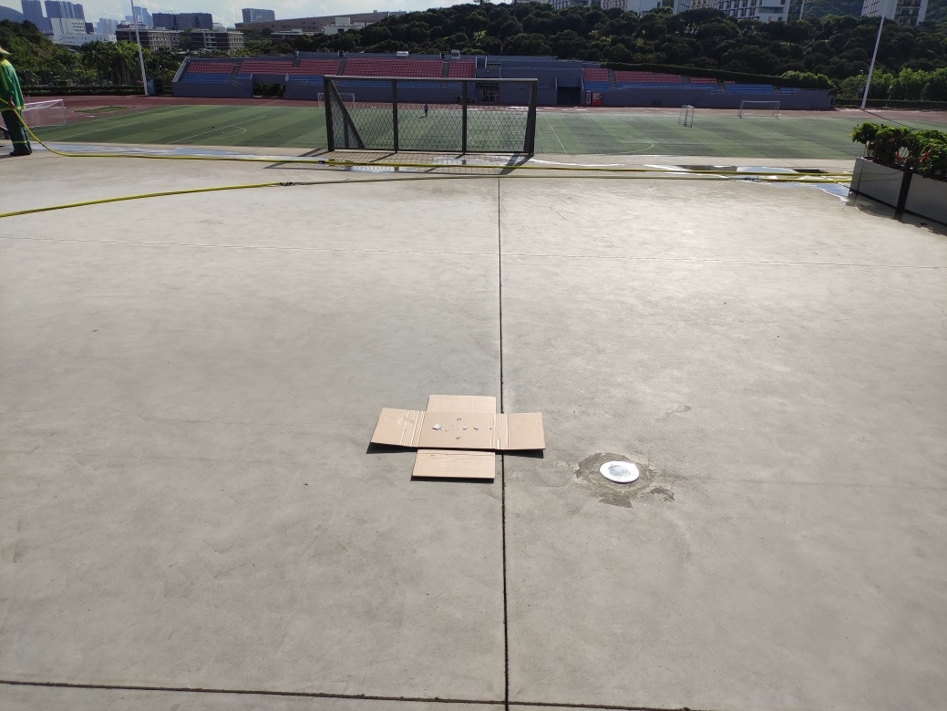
Experience Detail
experiment procedure

Slide 35
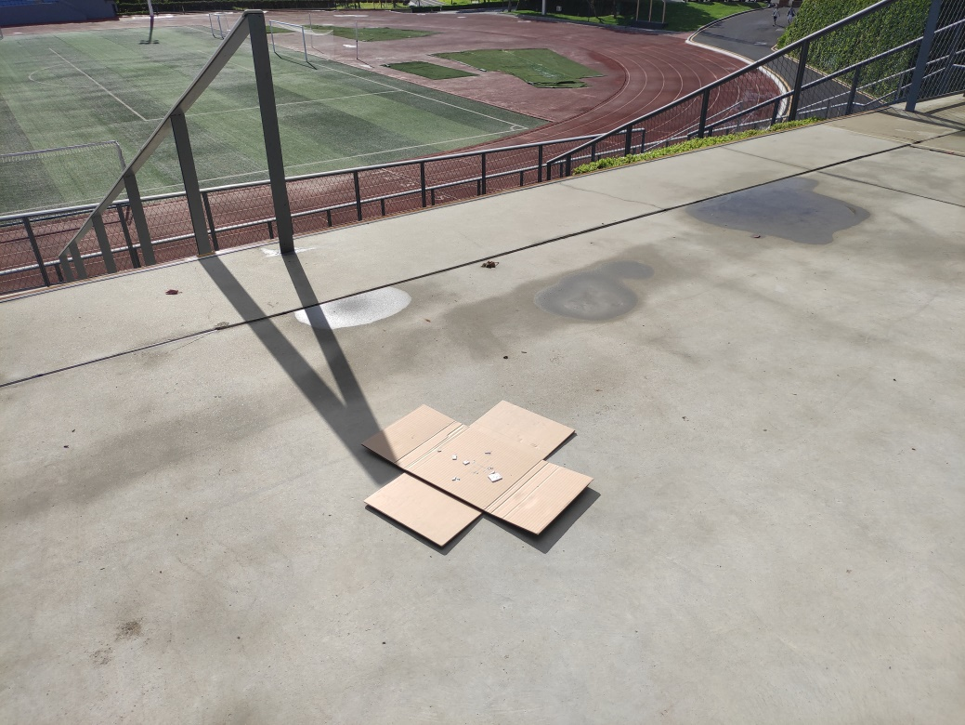
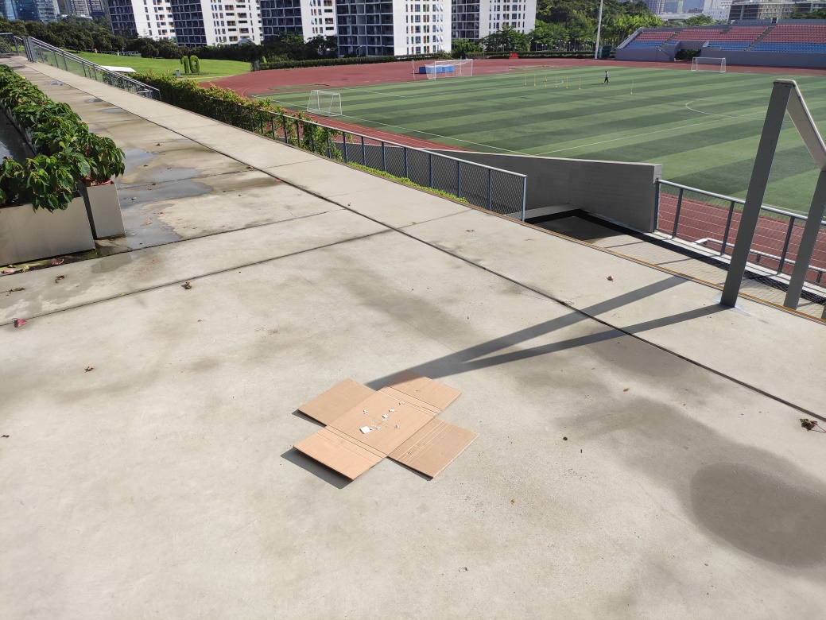
Experience Detail
experiment procedure

Slide 36
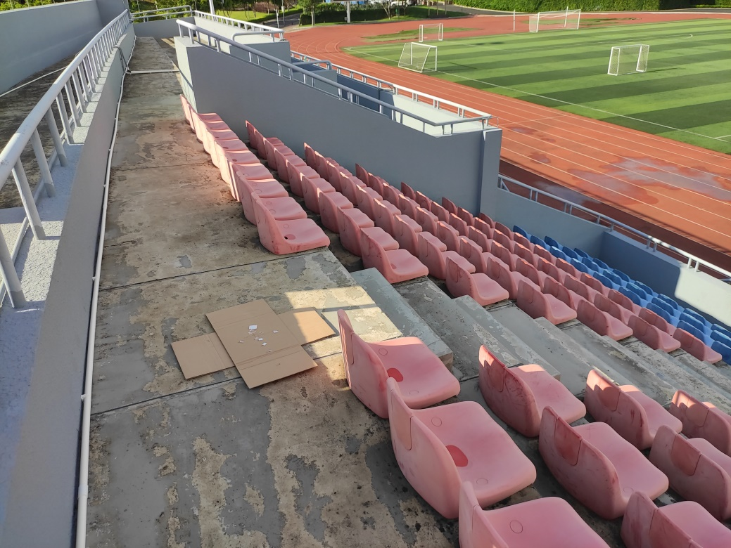
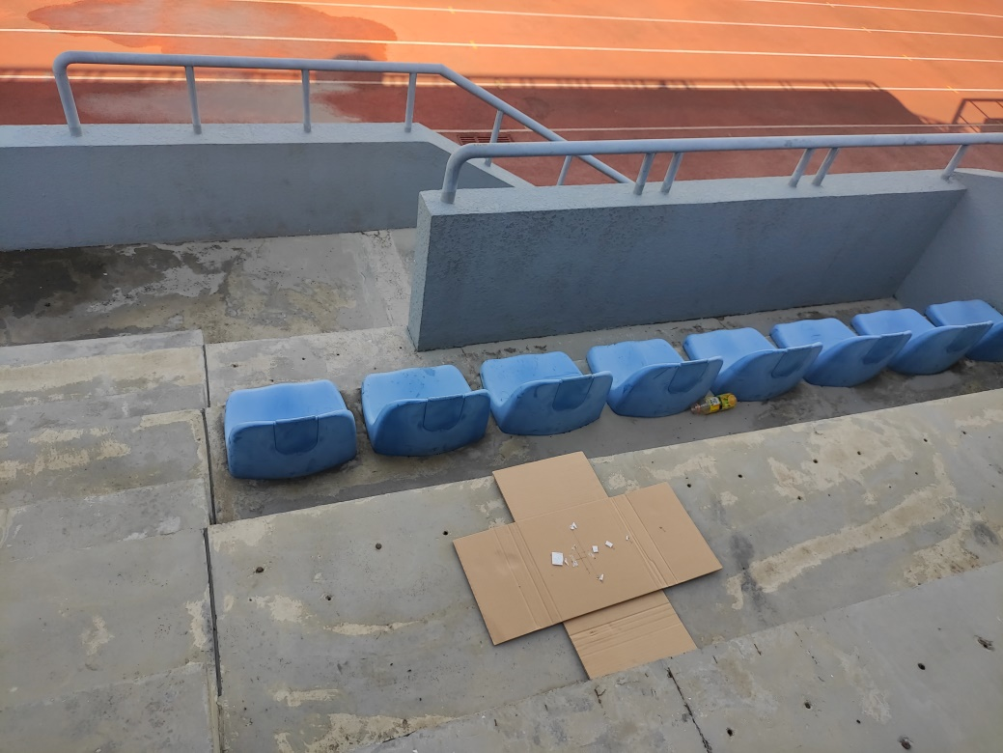
Experience Detail
experiment procedure

Slide 37


Experience Detail
experiment procedure

Slide 38


Experience Detail
experiment procedure

Slide 39


Experience Detail
experiment procedure

Slide 40


Experience Detail
experiment procedure

Slide 41
Fifth
Conclusion

Slide 42
Conclusion
我们进行了多种验证实验，分别通过直接采集数据离线处理、通过平台在线处理来实现了DOA估计
再此基础上，完成了Range-Doppler也就是测距和测速的工作

Slide 43
Thanks for
Watching!

